Slide 1
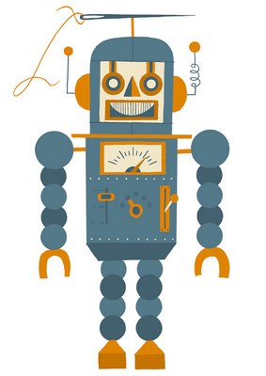
Body Parts!
with
Archibald the robot

Slide 2
RULES
The students are put in teams of 2.
Each team has a computer.
One student is clicking on the right answer while the other helps him to find it.
When they found the right answer, they switch places.
They have to play the game in a cooperative and harmonious way.

Slide 3
Show me where my body parts are by clicking on it.
Let’s start!
Click

Slide 4
1-Where is my nose?

Slide 5
2-Where is my mouth?

Slide 6
3-Where is my foot?

Slide 7
4-Where is my chest?

Slide 8
5-Where is my arm?

Slide 9
6-Where is my eye?

Slide 10
7-Where is my shoulder?

Slide 11
8-Where is my ear?

Slide 12
9-Where is my hand?

Slide 13
10-Where is my leg?

Slide 14
Congratulations!
Go to the next question

Slide 15
Congratulations!
Go to the next question

Slide 16
Congratulations!
Go to the next question

Slide 17
Congratulations!
Go to the next question

Slide 18
Congratulations!
Go to the next question

Slide 19
Congratulations!
Go to the next question

Slide 20
Congratulations!
Go to the next question

Slide 21
Congratulations!
Go to the next question

Slide 22
Congratulations!
Go to the next question

Slide 23
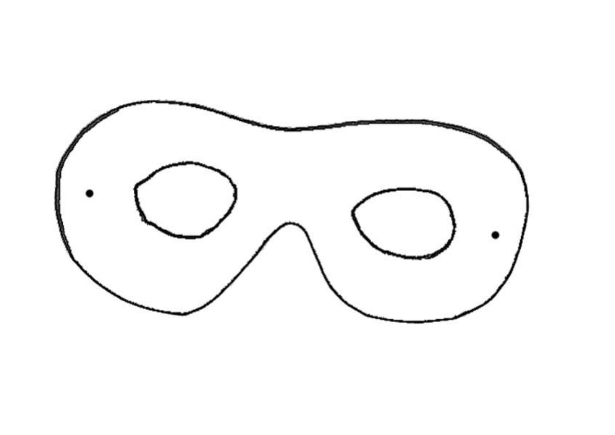
Congratulations!
Thank you! Now I know my body parts… and you also! ☺
By
Marino
Ethier
and
Audray
Roy

Slide 24
Wrong answer.
Try again!
Go back to question
1
Click

Slide 25
Wrong answer.
Try again!
Go back to question
2
Click

Slide 26
Wrong answer.
Try again!
Go back to question
3
Click

Slide 27
Wrong answer.
Try again!
Go back to question
4
Click

Slide 28
Wrong answer.
Try again!
Go back to question
5
Click

Slide 29
Wrong answer.
Try again!
Go back to question
6
Click

Slide 30
Wrong answer.
Try again!
Go back to question
7
Click

Slide 31
Wrong answer.
Try again!
Go back to question
8
Click

Slide 32
Wrong answer.
Try again!
Go back to question
9
Click

Slide 33
Wrong answer.
Try again!
Go back to question
10
Click

